Slide 1
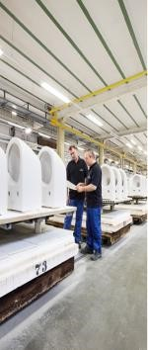
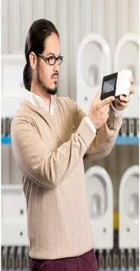
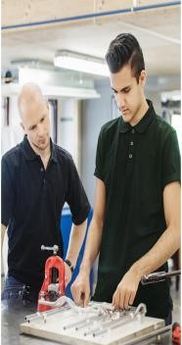
Continuous Improvement Coordinator
About Villeroy & Boch
Villeroy & Boch with headquarters in Mettlach /Germany has production facilities in Europe and Thailand. Villeroy & Boch is one of the world’s leading brands for ceramics and lifestyle. With our innovative and stylish products from the areas Bath & Wellness and Tableware we have been creating feel-good moments and spaces since our success is based on the high commitment and the inventiveness of our 7500 employees in 125 countries.
SC Mondial SA as part of the Villeroy & Boch groups is a ceramic production site with more then 40 year history on local market.
As Continuous Improvement Coordinator, you will be primarily responsible to identify improvement actions and areas for the processes, by using specific tools and methods.
Main tasks:
- Use continuous improvement techniques, to initiate process improvements, reduce production cycle time, reduce costs and other activities aimed to reduce / eliminate non-value-added activities in the process;
- Optimization of work processes, validates and assures the implementation of the new working standards;
- Propose actions to increase efficiency, process optimization and quality improvement;
- Evaluates the layout of lines, the ergonomics of workstations and propose improvement solution;
- Organize and moderate workshops or Kaizen events to achieve the improvement targets;
- Train the staff in Lean and problem-solving tools: responsible for coaching employees involved in improvement projects and methodologies;
- Plan and coordinate specific trainings with people involved in process improvement initiatives;
- Evaluate visual management systems and keep them aligned with the standards;
- Make results visible to management, through projects completion, specific meetings and reports;
- Regular reviews to ensure sustainability of the learned and applied methods.
Requirements:
- University degree Engineering;
- Professional experience in a production environment;
- Minim 3 years professional experience in Lean management;
- Good knowledge of continuous improvement systems and tools and Lean manufacturing methods;
- Hands-on approach, good analytical skills, attention to details; systematically approach with high degree of focus on results;
- Ability to search for problem-solving possibilities;
- Good command in English; - Advanced PC skills;
- Good organisational skills, sociable, correct attitude in the relationship with employees and collaborators, teamwork, communication skills and enthusiasm.
If you are interested in applying to these position, please send your CV by e-mail to:
lefter.andreea@villeroy-boch.com
Only selected candidates will be contacted.

